Slide 1

Semantic Folding

Slide 2

Why Talk About Semantic Folding?
Different Approach Than a Large Language Model
Doesn’t make any predictions using large data sets
No tuning necessary
Requires little computing power

Slide 3
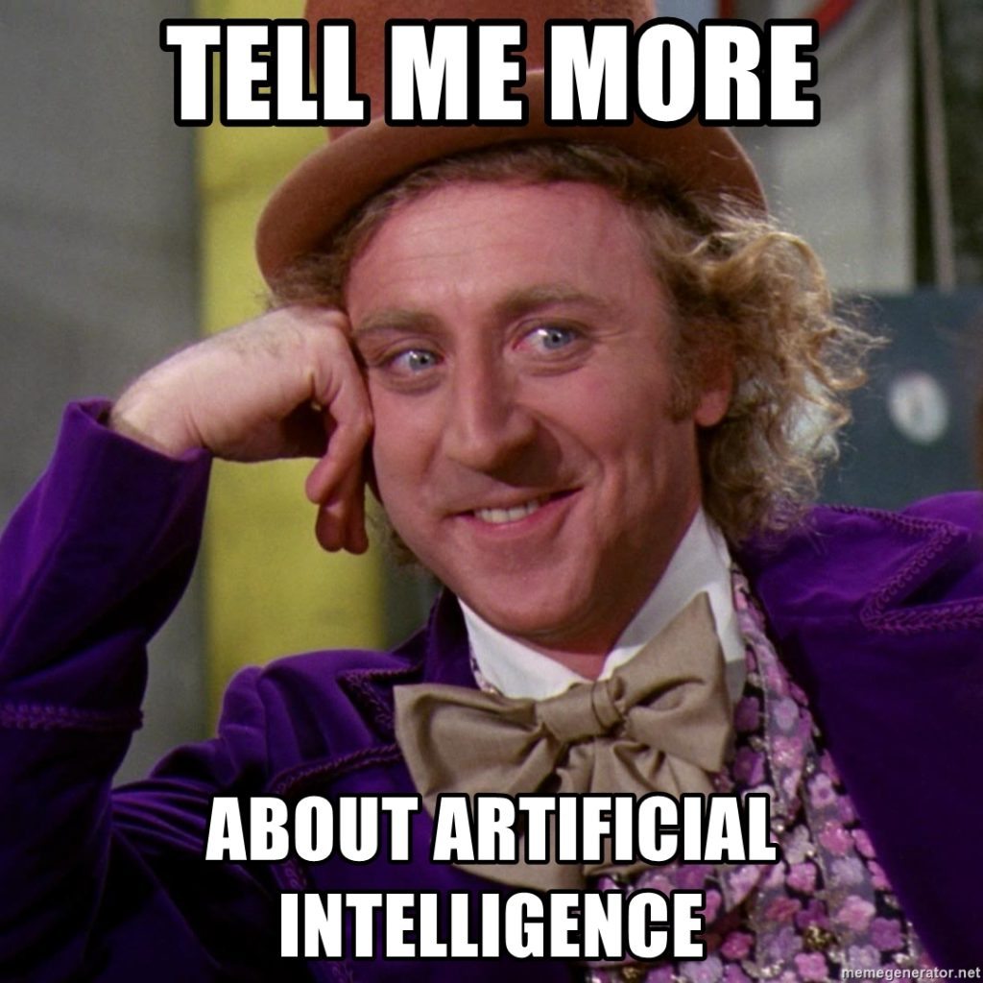
How do you think we can implement such an NLP model?

Slide 4
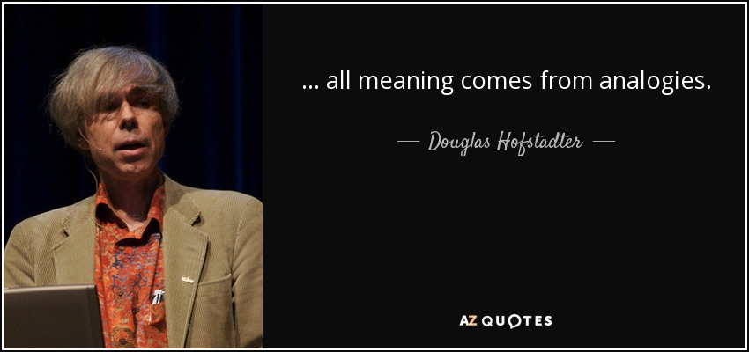
Background Information on Semantic Folding
Douglas R. Hofstadter (cognitive scientist)
Theorized that the human brain makes sense of the world through analogies
“Laptop” vs. “Computer”
Identifying new phenomena based on known similarities
Mapping the way the human brain thinks to a machine

Slide 5
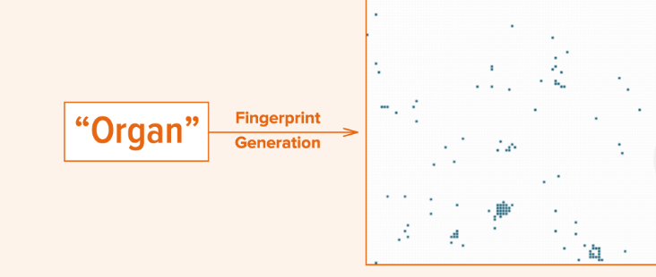
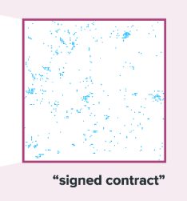
Converting text into a fingerprint
1 word
2+ words

Slide 6

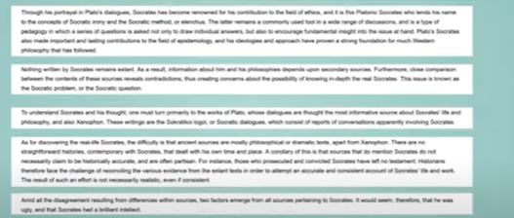
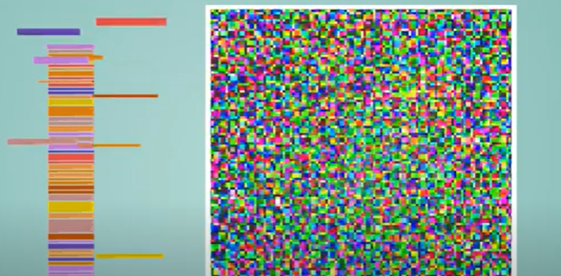
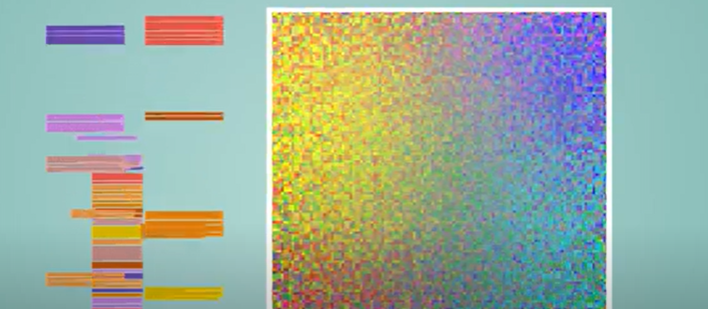
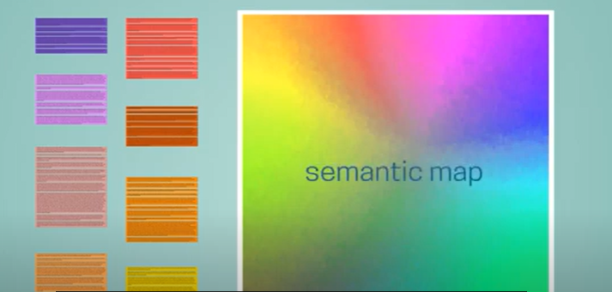
Setting Up the Semantic Folding Model
1) A document(s) gets fed into the model
2) The document(s) get subdivided into snippets of text
3) The text snippets get placed on a semantic grid
4) The text snippets more semantically similar are placed closer on the semantic grid
5) Clusters get formed around semantically similar text snippets

Slide 7
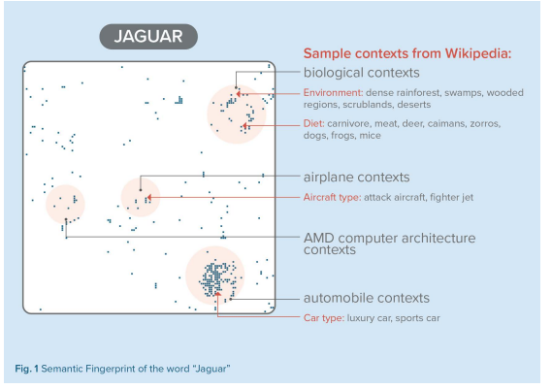
Dealing with a Single Word As Input
1) A word gets passed to the model
2) The model checks to see if any of its text snippets contain that word
3) For every snippet that contains that word, the coordinates of its position on the semantic grid gets portrayed on the fingerprint
4) The model also portrays the coordinates of other words in the snippet(s) on the semantic grid as well
5) Additionally, since the snippet(s) containing that word include other words, the model assigns a context for each cluster of snippets on the fingerprint
All the coordinate pairs together form the unique fingerprint associated with a given word

Slide 8
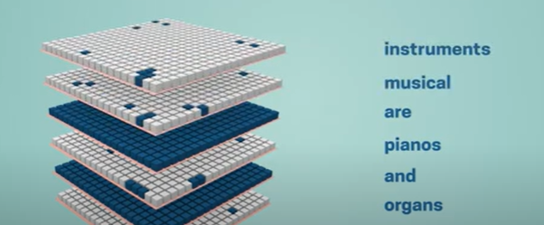
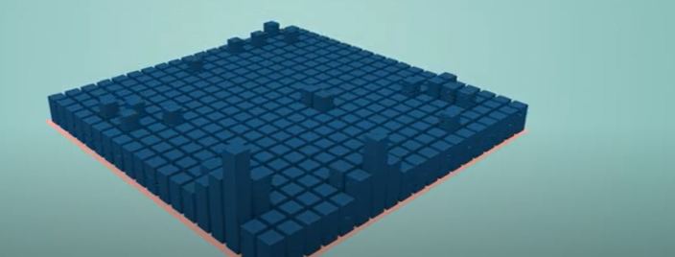
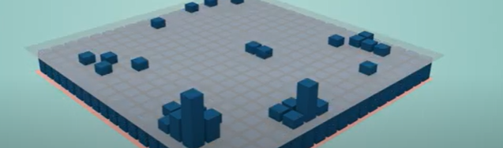
Dealing With More Than One Word As Input
1) A phrase, essay, etc. gets passed into the model
2) The model creates a separate fingerprint for every single word in the input
3) These fingerprints all get aggregated together into one fingerprint
4) However, the spare parts of the aggregated fingerprint only get shown
Organs and pianos are musical instruments.

Slide 9
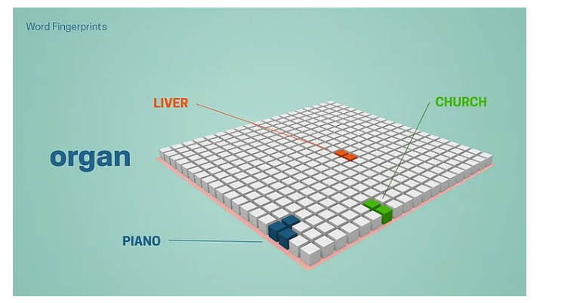
Unique Advantage of Semantic Folding
Grasping the meaning of words based on their given context

Slide 10
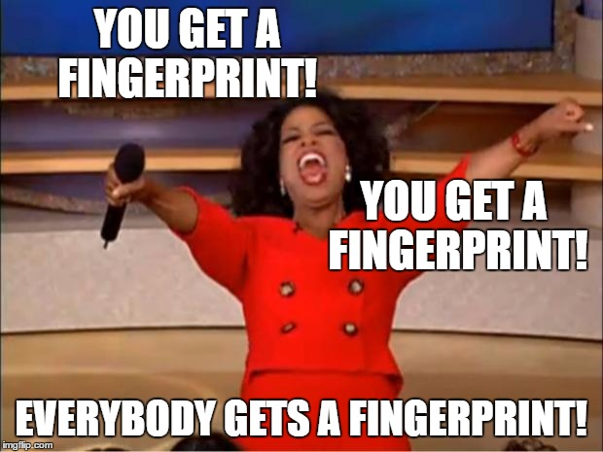
Which real-world applications do you think Semantic Folding can be useful for?

Slide 11
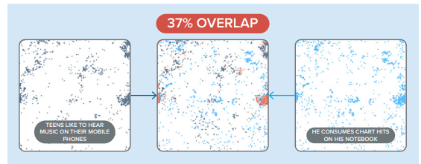
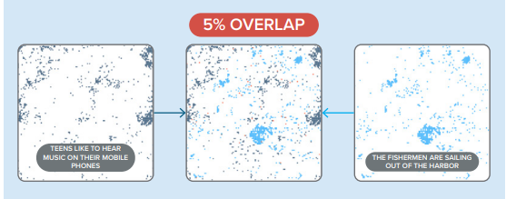
Several Applications of Semantic Folding
Comprehending documents
Detecting anomalies in data
Psychological Therapy

Slide 12
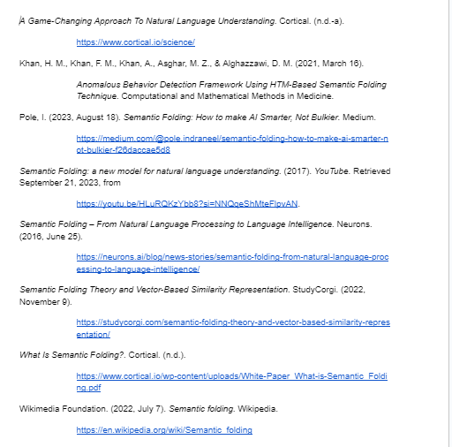
Presentation References

Slide 13
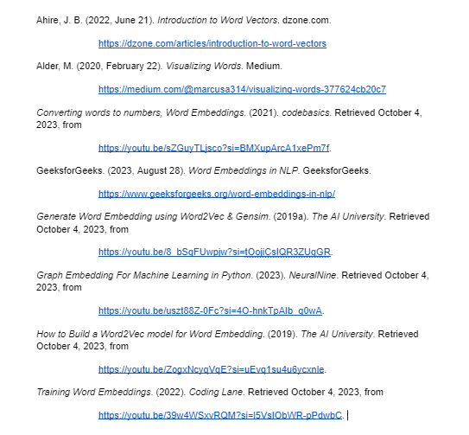
Worksheet and Code References

